Slide 1
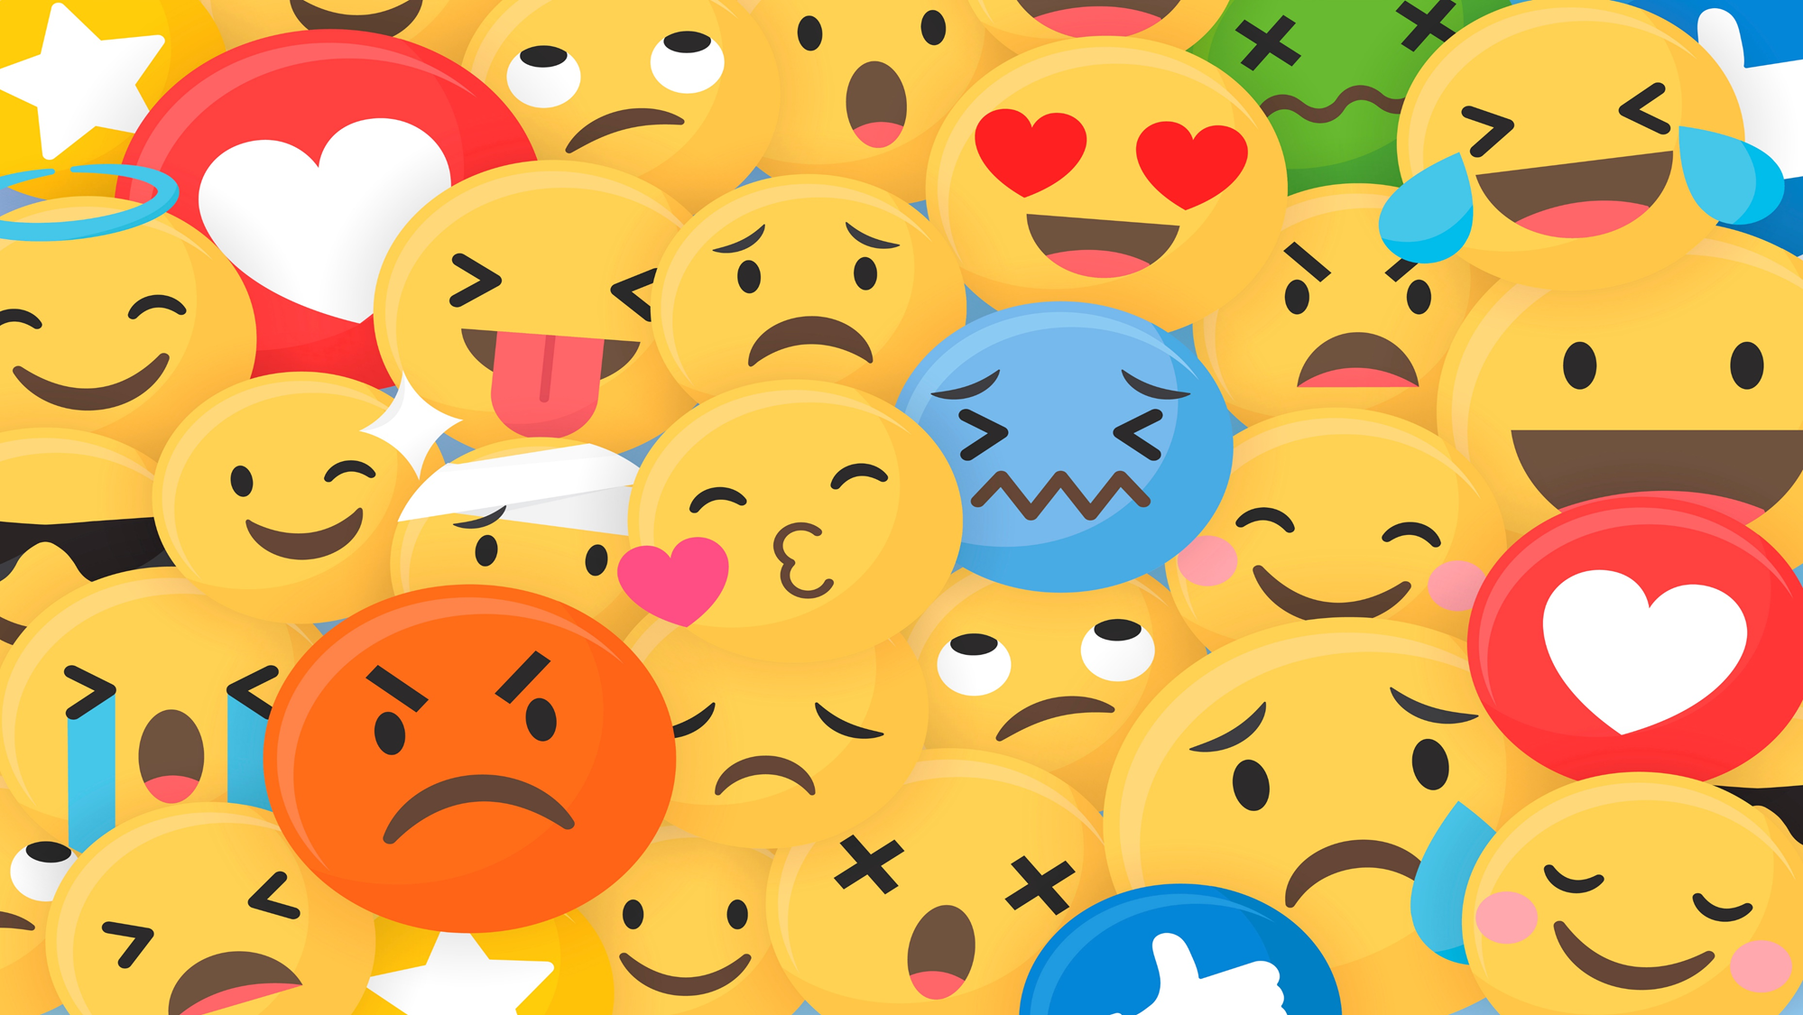
Using millions of emoji occurrences to learn any-domain representations for detecting sentiment, emotion and sarcasm.
B. Felbo, A. Mislove, A. Søgaard, I. Rahwan, S. Lehmann.
(2017)

Slide 2

Problem definition
Limitations in NLP caused by lack of manually annotated data
Distant Supervision (semi-supervised learning): compromises between unsupervised learning and supervised learning by extracting relations between entities, can also be considered weakly labelled training.
Past researchers have used simple emotion hashtags like #yuck, #fml, #joy, #anger, and others, while also using polar emoticons such as ☺ and ☹. (Mohammad, 2012; Deriu et al., 2016; Tang et al., 2014)
Notes:
There are Limitations in NLP caused by lack of manually annotated data. In some domains and tasks in NLP, it can be cost prohibitive or impractical to annotate data ourselves. As a result, past researchers have used a technique called distant supervision. Distant supervision, also called semi-supervised learning, compromises between unsupervised learning and supervised learning by extracting relations between entities. In that sense, it can be considered weakly labelled training. In state of the art approaches, researchers such as Deiru and Tang have used polarly defined emoticons as part of distant supervision. Similarly, hashtags such as yuck, fml, joy, anger, and others have been used by researchers such as Mohammad for mapping emotional categories.

Slide 3

More emoji is better
Distant supervision on noisy labels improves performance
More diverse set of noisy labels leads to richer representations of emotion
Proposed model expands to include 64 common emojis as part of the noisy labels in a dataset of 1.246 billion tweets across 5 domains
Emoji Diversity leads to better performance in emotion, sentiment, and sarcasm detection

Slide 4

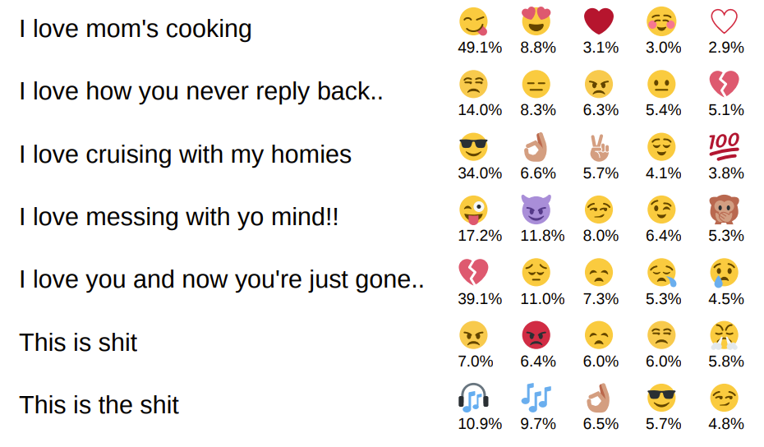


Emojis are not direct labelling
Emojis are not always a direct labelling, they can be used in different ways
Positive emoji can disambiguate ambiguous sentences or complement a negative sentence.
EX: I can’t believe you did that
Could be negative and angry, or it could be positive
I can’t believe you did that is clearly positive.
EX: I hate you so much
A clearly negative sentence inherently
I hate you so much complements the sentence and lightens the interpreted sentiment.
Nevertheless, DeepMoji is shown to capture and classify varied usages.
top five most likely emojis shown with the model’s probability estimates

Slide 5
Preprocessing and Pretraining
Emojis are a proxy for emotion of a text.
Before using transfer learning, we preprocess and pretrain the model.
Preprocessing filters out tweets with URLs, tokenizes word by word, and reduces words with 2 or more repeated characters to the same token (lol, loool, looooooool)

Slide 6

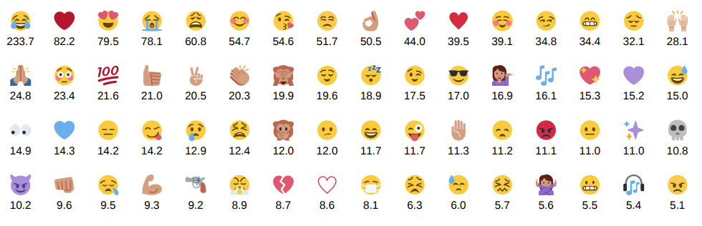
Preprocessing and Pretraining Cont.
In tweets with multiple unique emojis, a separate tweet is created with that emoji type as the label
To ensure rich understanding across emotional content in text, the pretraining set is balanced and randomly sampled for equal representation
Remaining data is upsampled
The number of tweets in the pretraining dataset associated with each emoji in millions.

Slide 7
Pretraining
After preprocessing the data, the model is pretrained by splitting the sample data and performing emoji prediction on tweets.
From the pretraining, a correlation matrix is established of the model’s predictions on the pretraining test set.

Slide 8
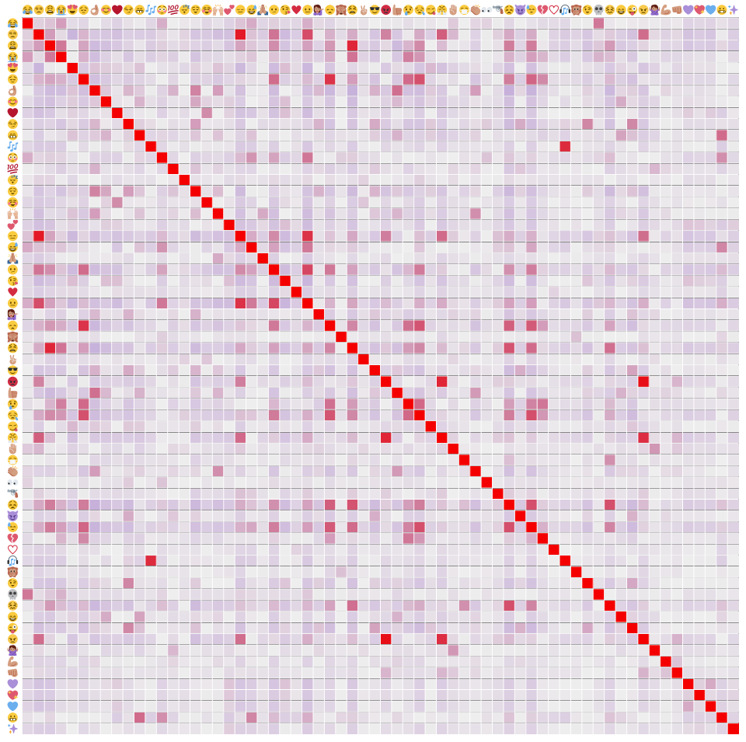
Correlation matrix of the model’s predictions on the pretraining test set.
Notes:
Compare sad/crying emojis and the disappointed emojis. The center line is for how they are the same. Red is the closest in similarity, white is least similar.

Slide 9
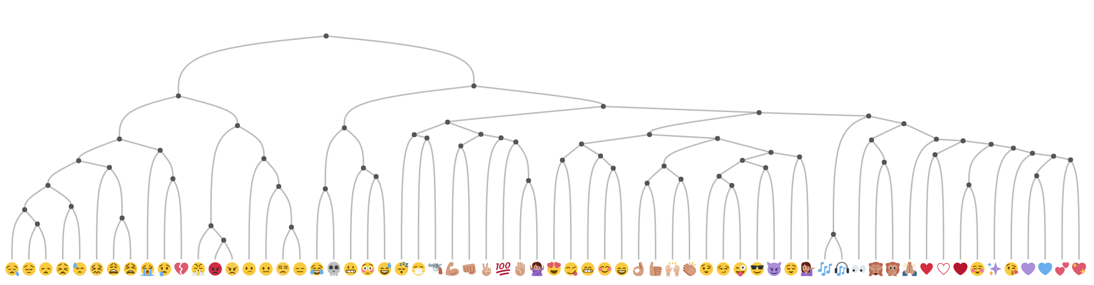
Using hierarchical clustering with average linkage on the correlation matrix, the dendrogram seen is generated
Notes:
To help visualize what relations the model is building from this confusion matrix, the authors constructed a dendrogram illustrating the relations that the model cam up with between emojis. This was constructed from the confusion matrix by hierarchal clustering by and average linkage. As you can see here, some of the red connections I pointed out earlier are shown here in this dendogram.

Slide 10
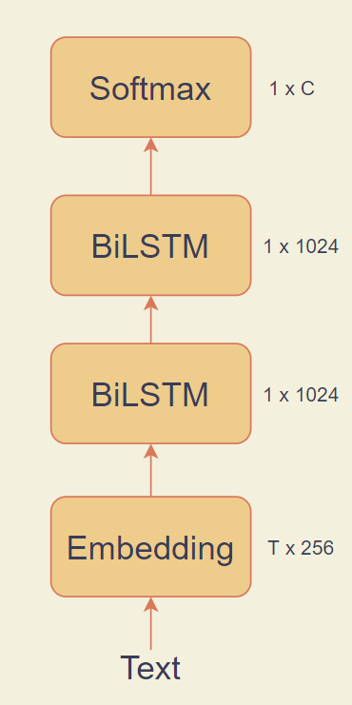
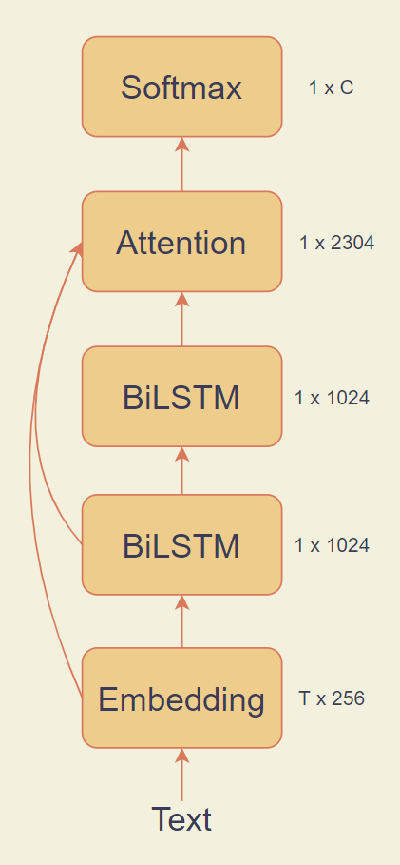
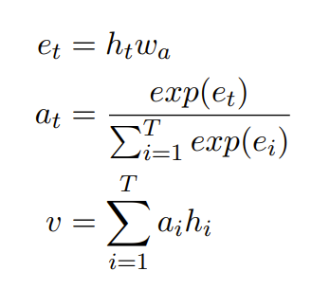
The DeepMoji Model
Deepmoji is based on the traditional LSTM model, with the distinction of the Attention layer.
Using skip connections, all of the layers of the process are considered by the Attention layer.
All layers are considered in attention layer so that the model can decide the importance of each word for the task.
Attention Mechanism
Traditional LSTM
DeepMoji model (S-text length, C-# of classes)
Notes:
So, here we have the traditional LSTM model and the Deepmoji model. As you can see here, the DeepMoji model is identical to the LSTM model, with the exception of the attention layer that it has between the second BiLSTM and the Softmax. What this Attention layer does is it takes in output of all of the layers of the process and considers all of them at the same time. In our formula here, ht is the representation of the word at time step t and wa is the weight matrix. Importance scores are gathered by multiplying the rweight matrix and normalizing it to construct a probability distribution. Then v, the representation vector is found through a summation of all the time steps and importance scores as weights.. The vector you get from this equation is an encoding of the text, which is given as input to the softmax layer. By including this attention layer, they are able to noticeably improve performance in transfer learning applications, as you’ll later see.
Attention layer detailed explanation:
Here ht is the representation of the word at time step t and wa is the weight matrix for the attention layer. The attention importance scores for each time step, at , are obtained by multiplying the representations with the weight matrix and then normalizing to construct a probability distribution over the words. Lastly, the representation vector for the text, v, is found by a weighted summation over all the time steps using the attention importance scores as weights. This representation vector obtained from the attention layer is a high-level encoding of the entire text, which is used as input to the final Softmax layer for classification. We find that adding the attention mechanism and skipconnections improves the model’s capabilities for transfer learning

Slide 11
Finetuning and reworking
The softmax can be replaced for solving new tasks without retraining the full model
If changing domains, transfer learning is needed.
Notes:
This softmax that I mentioned in the last slide can be replaced easily if you are solving new tasks, and you might not need to retrain the new model, however, if you do, such as if you are changing domains, you will need transfer learning

Slide 12
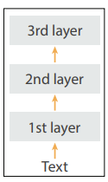
Transfer Learning - The Chain Thaw Approach
The pretrained model is fine tuned using a new, simple type of transfer learning called ‘Chain Thaw’
Chain Thaw has the following steps:
Notes:
The DeepMoji model describes a new simple transfer learning technique that they call the chain thaw approach. This model is used for incorporating and fine tuning the pretrained model. In this graphic, we have 3 layers for simplicity, but this is just done for simplicity. Chain thaw has the following steps

Slide 13
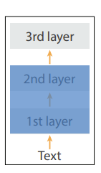
Transfer Learning - The Chain Thaw Approach
The pretrained model is fine tuned using a new, simple type of transfer learning called ‘Chain Thaw’
Chain Thaw has the following steps:
Tune any new layers until convergence on validation set
Notes:
First, you’ll tune all of your new layers until you’ve reached a convergence on the validation set. Often, this new layer is just the Softmax layer. As you’re tuning your new layer or layers, you’ll note that the other layers are blocked off. This means that at this stage, their values are not able to be changed or fine tuned.

Slide 14
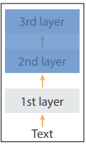
Transfer Learning - The Chain Thaw Approach
The pretrained model is fine tuned using a new, simple type of transfer learning called ‘Chain Thaw’
Chain Thaw has the following steps:
Tune any new layers until convergence on validation set
Tune the first layer
Notes:
Now for the next step, we freeze all of the layers except for the first, and we fine tune the first layer

Slide 15
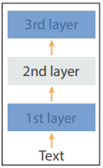
Transfer Learning - The Chain Thaw Approach
The pretrained model is fine tuned using a new, simple type of transfer learning called ‘Chain Thaw’
Chain Thaw has the following steps:
Tune any new layers until convergence on validation set
Tune the first layer
Tune all remaining layers, one at a time
Notes:
This process will continue, with us finetuning one layer at a time, and freezing all other layers as we move forward.

Slide 16
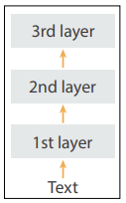
Transfer Learning - The Chain Thaw Approach
The pretrained model is fine tuned using a new, simple type of transfer learning called ‘Chain Thaw’
Chain Thaw has the following steps:
Tune any new layers until convergence on validation set
Tune the first layer
Tune all remaining layers, one at a time
Tune all layers together
Notes:
Once all of the layers have been fine tuned individually, they are fine tuned together, all at once.

Slide 17
Transfer Learning - The Chain Thaw Approach
The pretrained model is fine tuned using a new, simple type of transfer learning called ‘Chain Thaw’
Chain Thaw has the following steps:
Tune any new layers until convergence on validation set
Tune the first layer
Tune all remaining layers, one at a time
Tune all layers together
Chain thaw has the advantage of allowing one to expand the vocabulary to new domains without overfitting.
Notes:
Each time the model converges on the validation set, the weights are reloaded to the best setting. Because of this, the chain thaw approach prevents overfitting. Chain thaw has the benefit of being able to expand the vocabulary of a model without overfitting and provides good flexibility through transfer learning.

Slide 18

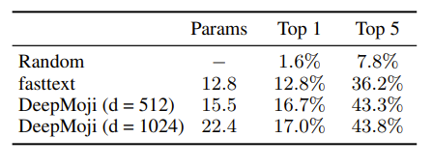
Experiments – Emoji Prediction
DeepMoji is evaluated against random selection and a previously competitive bag of words classifier, fastText (Joulin et al., 2016).
Top 1 and Top 5 accuracies are chosen because the noisy emoji labels means that multiple correct labels are possible
Results highlight the difficulty of the task, as well as the importance of capturing the context of each word
Accuracy on Emoji Prediction, d is dimensionality of each LSTM layer, Parameters are in millions.
Notes:
So, for the experiments for DeepMoji, they conduct emoji prediction and three separate benchmark tasks. Starting off by evaluating emoji prediction, DeepMoji is compared against random selection and a previous bag of words classifier, fastText. DeepMoji is similar to fasttext except that it has LSTM layers and an attention layer between the embedding and softmax layer.

Slide 19

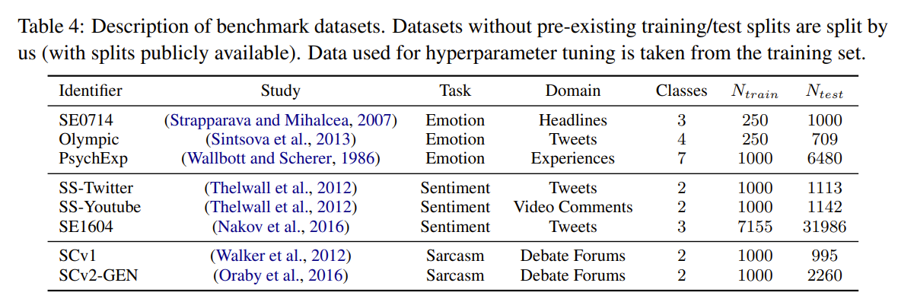
Experiments – Benchmarking
3 NLP tasks are evaluated across 8 datasets and 5 domains

Slide 20
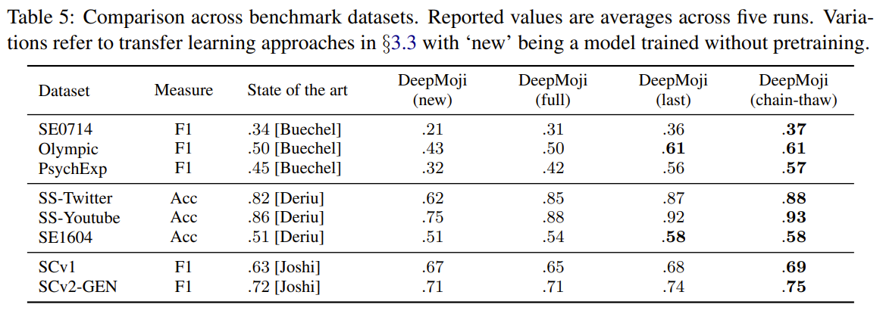
Experiments – Benchmarking
DeepMoji with Chain Thaw transfer learning performs best on all tasks, performance given in accuracy
Notes:
DeepMoji new designates the model without the pretraining
DeepMoji full uses the pretrained model as initialization and trains it as unfrozen
DeepMoji last is where all layers are frozen in the model when fine tuning except the last
DeepMoji chain thaw implements the chain thaw method previously defined

Slide 21
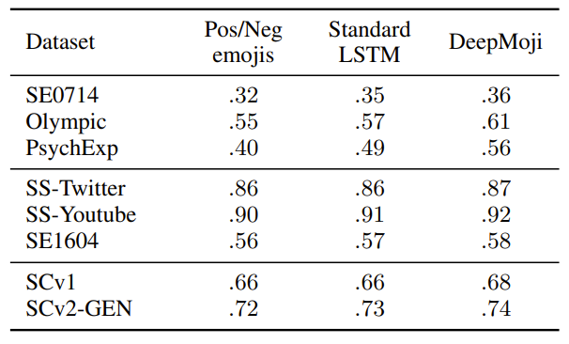
Model Analysis – Component Importance
Performance of DeepMoji shown to improve by including more emojis than just positive/negative, even on sentiment tasks
Addition of attention layer is shown to improve transfer learning, but not necessarily single supervised classification with ample available data.
Performance given in accuracy
Notes:
Here, the deepmoji shown is not using the chain thaw method, and instead, both LSTM and DeepMoji are using ‘last’ transfer learning approach
Pos/neg is DeepMoji but with only positive and negative emojis included Standard LSTM is DeepMoji but without the attention layer

Slide 22
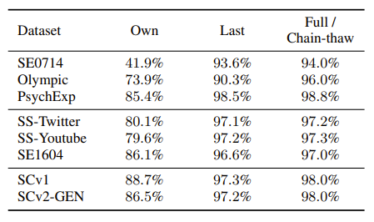
Model Analysis – The Effect of Pretraining
The performance gap between DeepMoji(new) and DeepMoji(chain-thaw) is evaluated by comparing the effect of the pretraining and chain thaw transfer learning.
A considerable improvement is shown in the pretraining data alone, with fine-tuning showing a greater improvement
Benefits extend beyond word coverage, as pretrain contains so many occurences of each word that it is possible to learn emotional and semantic meanings.
Percentages are based on word coverage on benchmark tests
Notes:
Own represents word coverage in training data
Last represents word coverage in pretraining data
Full/chain thaw represents including both through chain thaw method

Slide 23


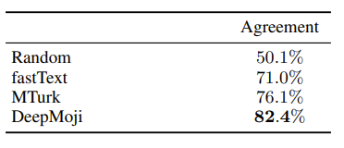
Model Analysis – outperforms
To test how DeepMoji compares to human classification, Amazon Mechanical Turk workers were hired to classify the sentiment of tweets on a 1 to 9 scale with a do not know option
For each tweet, a random MTurk worker of a random rating is chosen and 9 other MTurk workers ratings are averaged to form a ground truth for comparison.
Using this test, DeepMoji was found to agree with the 9 other MTurk ratings with 82.4% accuracy, compared to the 76.1% chance that a random MTurk worker would.
Percentages based on agreement with MTurk Average

Slide 24

Conclusion and Takeaways
Pretraining followed by fine tuning is very beneficial for transfer learning and usecases/domains where there is limited annotated data.
DeepMoji not only outperforms state of the art methods, but it even outperforms the average Mechanical Turk worker at sentiment analysis.
Emojis that are not polar in terms of sentiment analysis can still noticeably improve sentiment analysis if included in training process.
*average MTurk worker, not representative of all humans, obviously

Slide 25
Citations
Saif Mohammad. 2012. #emotional tweets. In The First Joint Conference on Lexical and Computational Semantics (*SEM), pages 246–255. Association for Computational Linguistics.
Jan Deriu, Maurice Gonzenbach, Fatih Uzdilli, Aurelien Lucchi, Valeria De Luca, and Martin Jaggi. 2016. Swisscheese at semeval-2016 task 4: Sentiment classification using an ensemble of convolutional neural networks with distant supervision. Proceedings of SemEval, pages 1124–1128.
Duyu Tang, Furu Wei, Nan Yang, Ming Zhou, Ting Liu, and Bing Qin. 2014. Learning sentimentspecific word embedding for twitter sentiment classification. In 52th Annual Meeting of the Association for Computational Linguistics (ACL), pages 1555–1565.
Armand Joulin, Edouard Grave, Piotr Bojanowski, and Tomas Mikolov. 2016. Bag of tricks for efficient text classification. arXiv preprint arXiv:1607.01759.

